Slide 1


Evelyn - AI

Slide 2
What can it do?
Recommend books, videos, articles and magazines for a student.
Tell you which jobs suit you the most.
Other
Understand humour
Friendly conversation
Cognitive
Intuitive

Slide 3
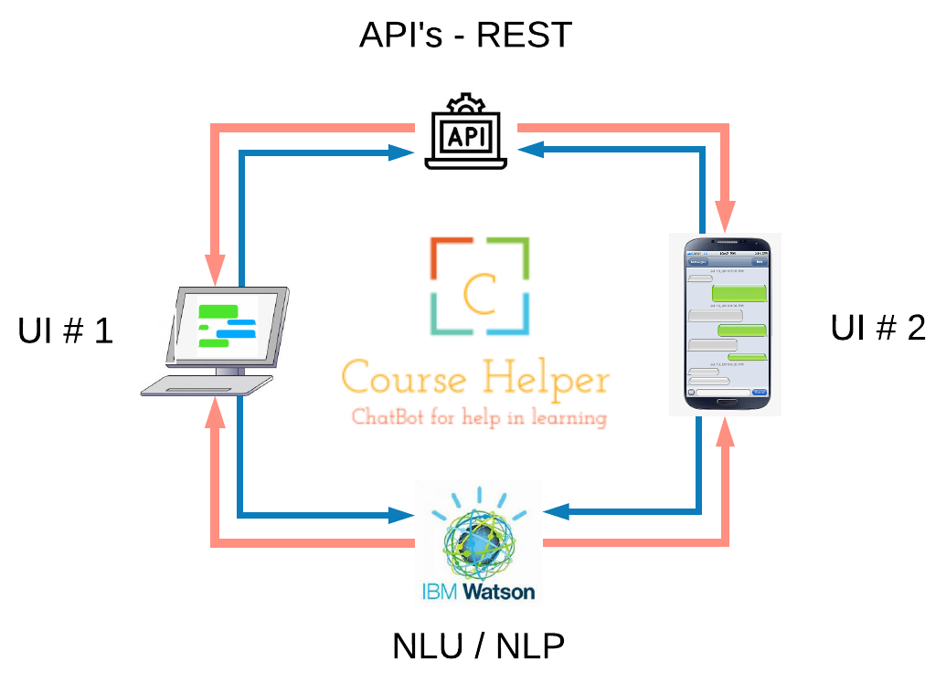
How does it work?
Youtube, Google, Amazon, E-bay
Any Browser
Node
HTML CSS
Android APK
Javascript
XML

Slide 4
Front end User Interface (UI)
Laptop / PC with web browser
Chrome
Firefox
Edge
Mobile phone
IOS
ANDROID
Can you find a book for me?
I need to see a video on differentiation
I know how to ….. What jobs suit me?
Tell me a joke ☺

Slide 5
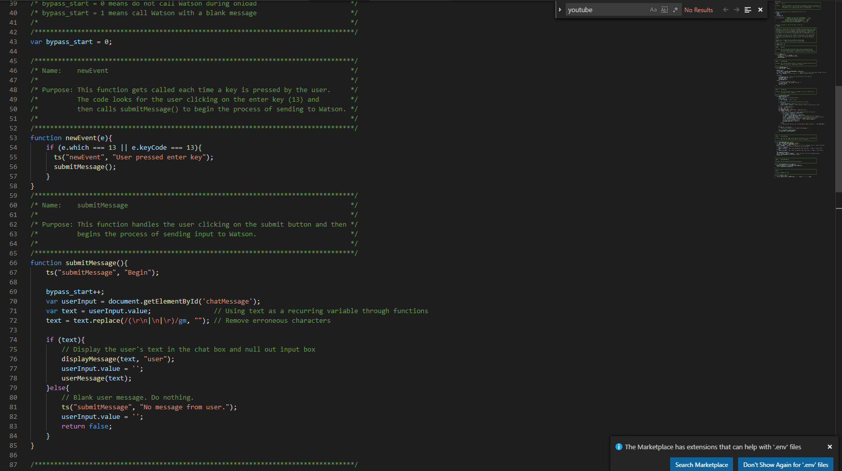

Slide 6

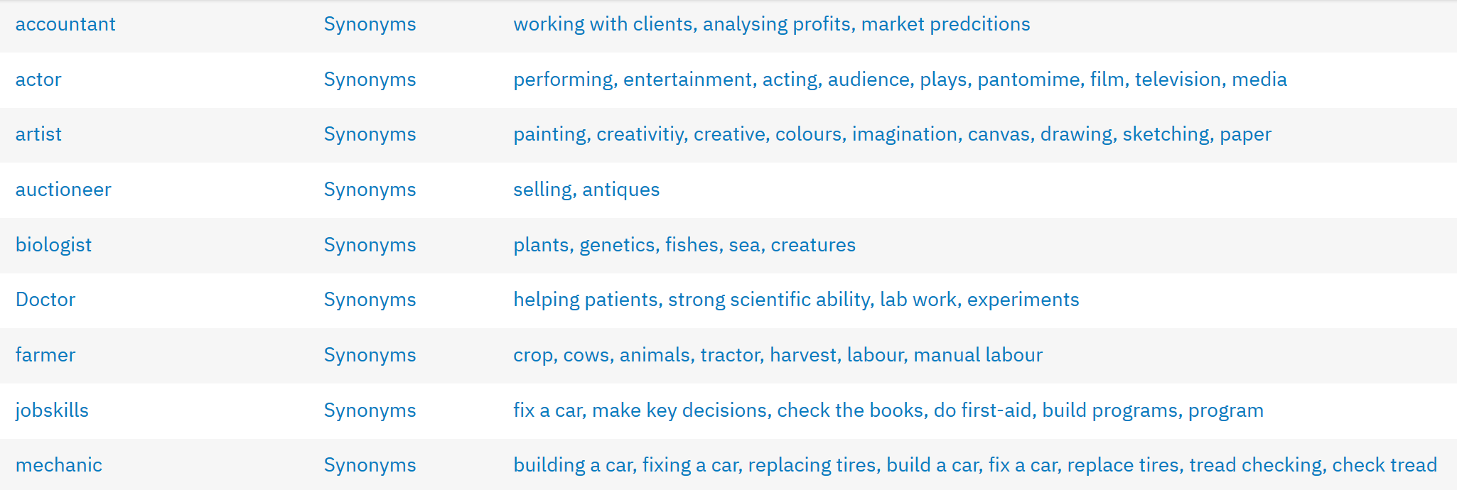
Output - IBM – Watson AI
What’s your major skill?
I’m really good at working with banking clients!
Wow, that’s impressive
Let me have a look for you
Thanks ☺
Hmm – I’m thinking financial analyst

Slide 7
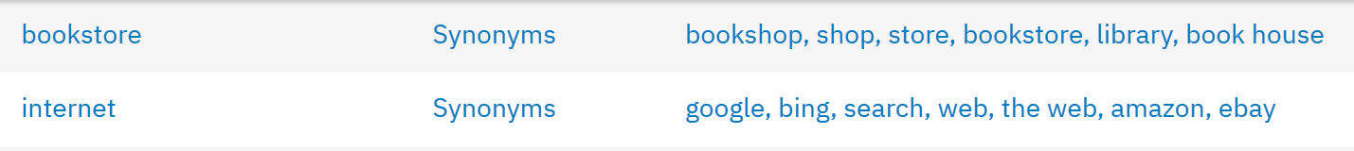
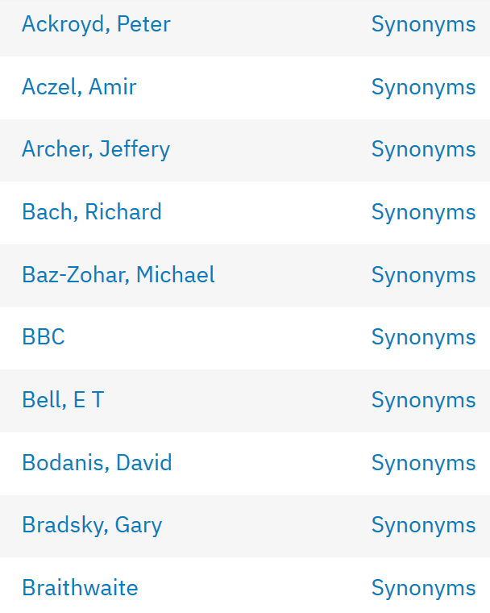
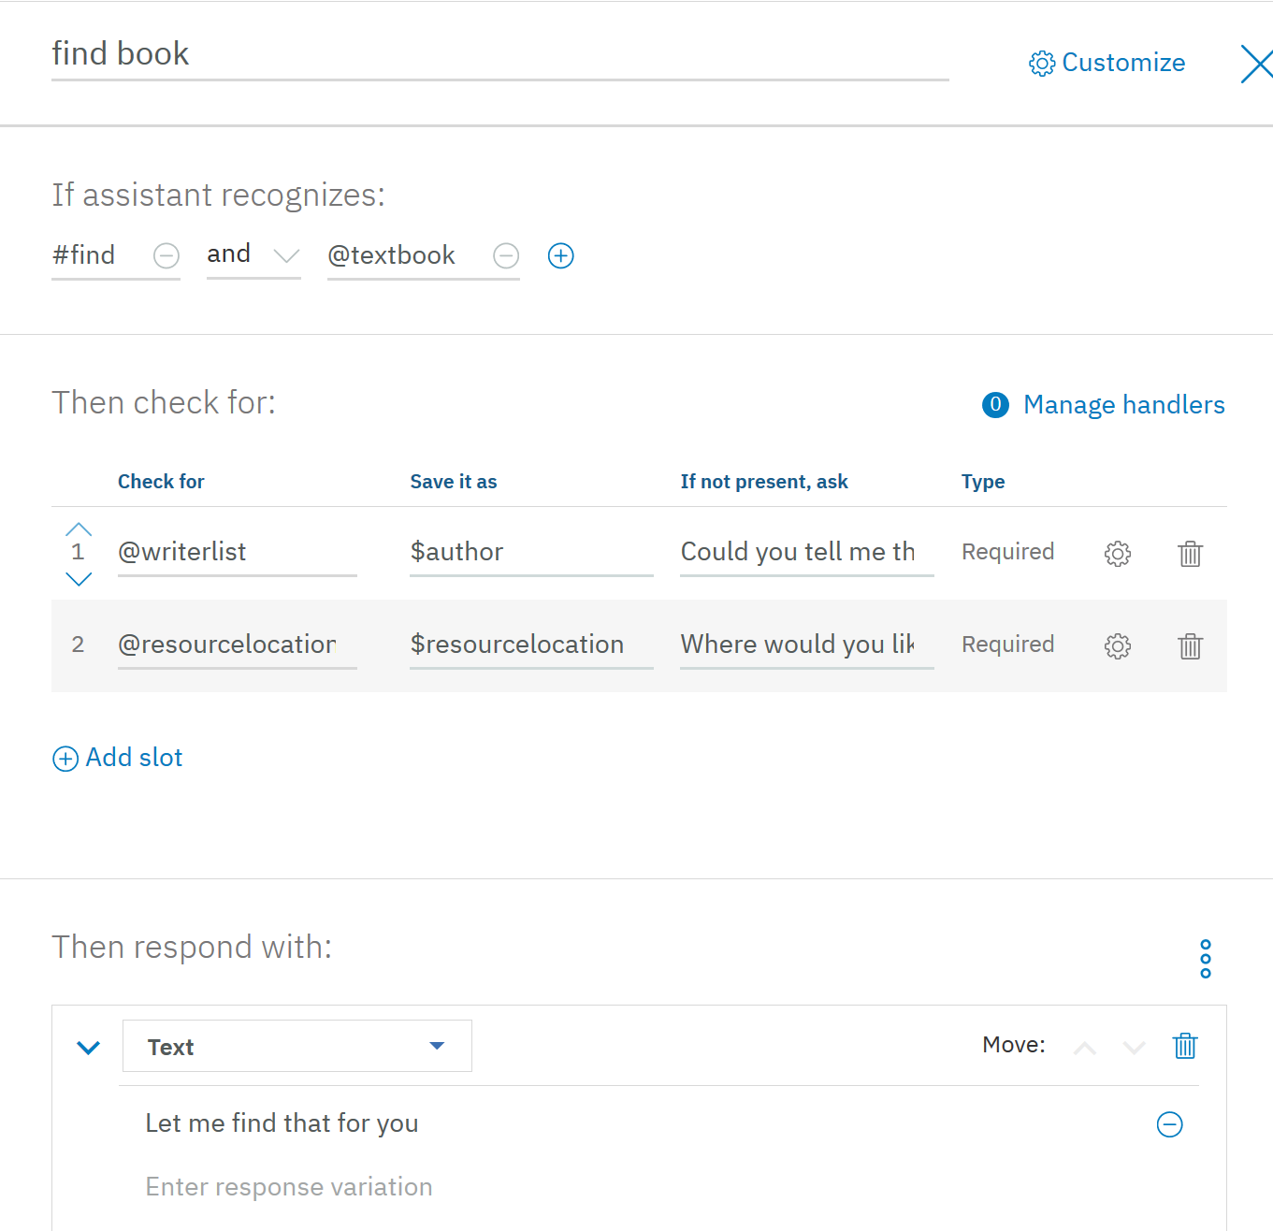
Output - IBM – Watson AI
Could you tell me the author’s name?
Sure, its Stephen Hawking
And where would you like me to find it?
E-Bay

Slide 8




The team
Tomiwa Ogunbamowo
Back-end Development
Sanabil Qureshi
Front-end development
Stephen Bulsara
Front-end development
Jason Francis
Back-end development

